Slide 1
Laravel: Security
Course Code: CSC 4182
Course Title: Advanced Programming In Web Technologies
Dept. of Computer Science
Faculty of Science and Technology
Lecture No: | 19 | Week No: | 12 | Semester: | Summer 2020-2021
Lecturer: | MD.AL-AMIN; alamin@aiub.edu

Slide 2
Lecture Outline
Introduction to middleware
Application security
Introduction to DB Migration
Laravel authentication

Slide 3
Introduction to middleware
Middleware provide a convenient mechanism for filtering HTTP requests entering your application.
Laravel includes a middleware that verifies the user of your application is authenticated.
To create a new middleware, use the make:middleware Artisan command:
php artisan make:middleware CheckAge
This command will place a new CheckAge class within your app/Http/Middleware directory.
In this class we need to define handle function($request, Closure $next)
public function handle($request, Closure $next)
{
if ($request->age <= 17) {
return redirect('hello');
}
return $next($request);
}
Notes:
if the given age is less than or equal to 200, the middleware will return an HTTP redirect to the client; otherwise, the request will be passed further into the application. To pass the request deeper into the application (allowing the middleware to "pass"), call the $next callback with the $request.

Slide 4
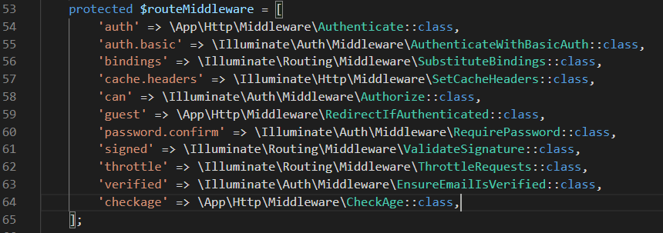
Introduction to Middleware
To use this middleware we need to register it first in our kernel class.
If you would like to assign middleware to specific routes, you should first assign the middleware a key in your app/Http/Kernel.php file
If you want a middleware to run during every HTTP request to your application, list the middleware class in the $middleware property of your app/Http/Kernel.php class.
To run in specific request or in a group of request add into $routeMiddleware property. This property contains entries for the middleware included with Laravel. To add your own, append it to this list and assign it a key of your choosing.

Slide 5
Introduction to Middleware
To apply middleware in request while defining route you need to pass the request to middlware
Route::get('/registration','PagesController@registration')
->middleware('checkage');;
Now when ever we request for /registration we need to pass a age value either by get or post greater or equal than 18. Otherwise it will redirect us to hello page.
Try http://localhost:8082/registration?age=18
Try http://localhost:8082/registration?age=15
Try http://localhost:8082/registration

Slide 6
Application security
CSRF
Laravel makes it easy to protect your application from cross-site request forgery (CSRF) attacks.
Cross-site request forgeries are a type of malicious exploit whereby unauthorized commands are performed on behalf of an authenticated user.
Laravel automatically generates a CSRF "token" for each active user session managed by the application.
This token is used to verify that the authenticated user is the one actually making the requests to the application.
Anytime you define an HTML form in your application, you should include a hidden CSRF token field in the form so that the CSRF protection middleware can validate the request.
You may use the @csrf Blade directive to generate the token field
<form method="POST" action="/profile">
@csrf
...
</form>
Notes:
The VerifyCsrfToken middleware, which is included in the web middleware group, will automatically verify that the token in the request input matches the token stored in the session.

Slide 7
Introduction to DB Migration
Topic sub heading..
Migrations are like version control for your database, allowing your team to modify and share the application's database schema.
Migrations are typically paired with Laravel's schema builder to build your application's database schema.
To create a migration, use the make:migration
The new migration will be placed in your database/migrations directory.
Each migration file name contains a timestamp, which allows Laravel to determine the order of the migrations.
The --table and --create options may also be used to indicate the name of the table and whether or not the migration will be creating a new table.

Slide 8
Migration Structure
A migration class contains two methods: up and down.
The up method is used to add new tables, columns, or indexes to your database, while the down method should reverse the operations performed by the up method.
public function up()
{
Schema::create('flights', function (Blueprint $table) {
$table->id();
$table->string('name');
$table->string('airline');
$table->timestamps();
});
}
public function down()
{
Schema::drop('flights');
}

Slide 9
Migration Methods
To run all of your outstanding migrations, execute the migrate Artisan command
php artisan migrate
To roll back the latest migration operation, you may use the rollback command.
php artisan migrate:rollback
Drop All Tables & Migrate
php artisan migrate:fresh
php artisan migrate:fresh –seed

Slide 10
Laravel Authentication
Laravel makes implementing authentication very simple.
The authentication configuration file is located at config/auth.php
By default, Laravel includes an App\User Eloquent model in your app directory.
Laravel's laravel/ui package provides a quick way to scaffold all of the routes
composer require laravel/ui
php artisan ui vue –auth
For laravel version less than 6.0 you can use
php artisan make_auth
This will automatically create required blade files, controller and routes.
You may access the authenticated user via the Auth façade
use Illuminate\Support\Facades\Auth;
// Get the currently authenticated user...
$user = Auth::user();
// Get the currently authenticated user's ID...
$id = Auth::id();

Slide 11
Laravel Authentication
Alternatively, once a user is authenticated, you may access the authenticated user via an Illuminate\Http\Request instance.
$request->user() returns an instance of the authenticated user..
Determining If The Current User Is Authenticated
if (Auth::check()) {
// The user is logged in...
}
Route middleware can be used to only allow authenticated users to access a given route. Laravel ships with an auth middleware, which is defined at Illuminate\Auth\Middleware\Authenticate.
Route::get('profile', function () {
// Only authenticated users may enter...
})->middleware('auth');
To log users out of your application, you may use the logout method on the Auth facade. This will clear the authentication information in the user's session
Auth::logout();

Slide 12
Books
PHP Advanced and Object-Oriented Programming, 3rd Edition; Larry Ullman; Peachpit, Press, 2013
PHP Objects, Patterns and Practice, 5th Edition; Matt Zandstra; Apress, 2016
Learning PHP, MySQL, JavaScript and CSS, 2nd Edition; Robin Nixon; O’Reilly, 2009
Eloquent JavaScript: A Modern Introduction to Programming; Marijn Haverbeke; 2011
Learning Node.js: A Hands On Guide to Building Web Applications in JavaScript; Marc Wandschneider; Addison-Wesley, 2013
Beginning Node.js; Basarat Ali Syed; Apress, 2014

Slide 13
References
https://laravel.com/docs/7.x/middleware
https://laravel.com/docs/7.x/csrf
https://laravel.com/docs/7.x/migrations

Slide 14
Thank You!

